Slide 1
NLP

Slide 2
Introduction to NLP
Linguistics

Slide 3
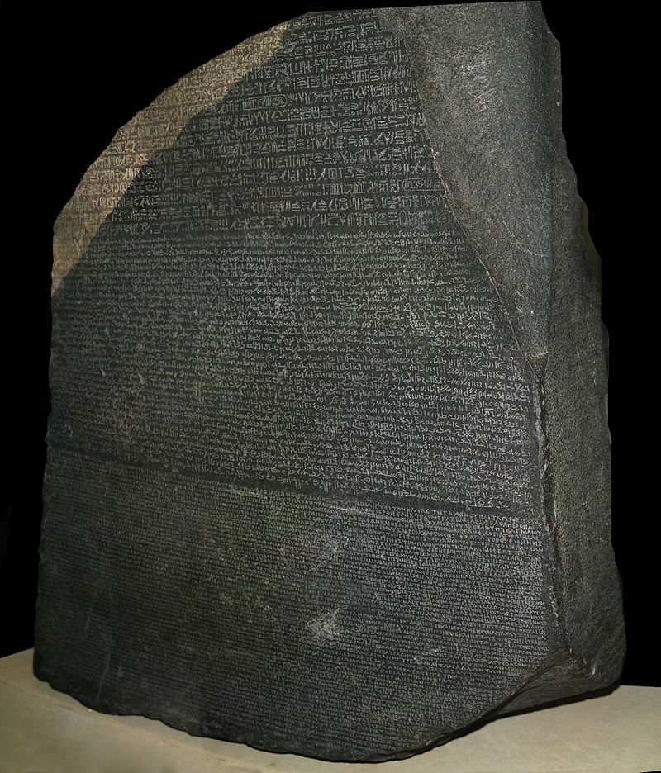
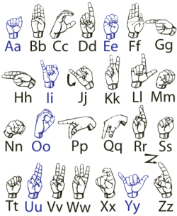
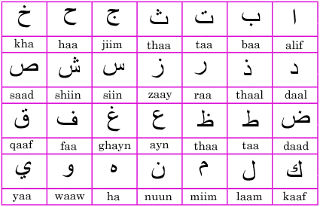
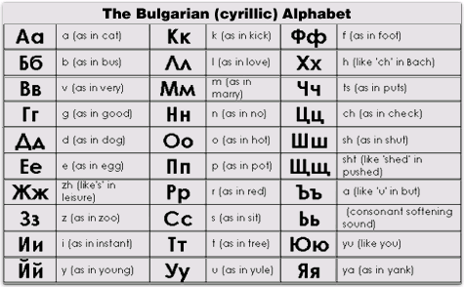
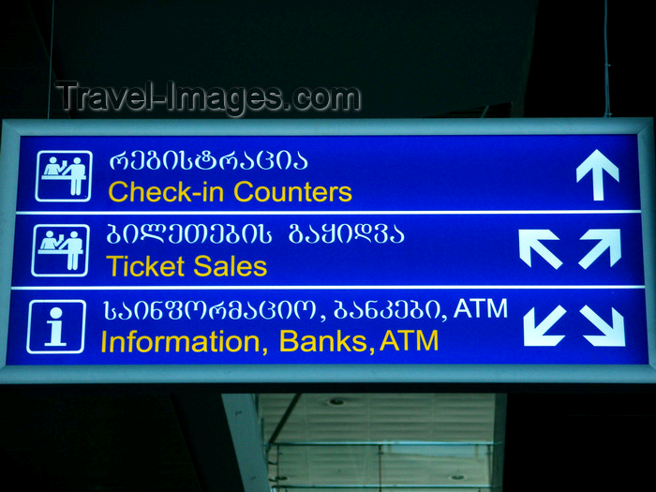
Notes:
CHECK ATTRIBUTIONS

Slide 4
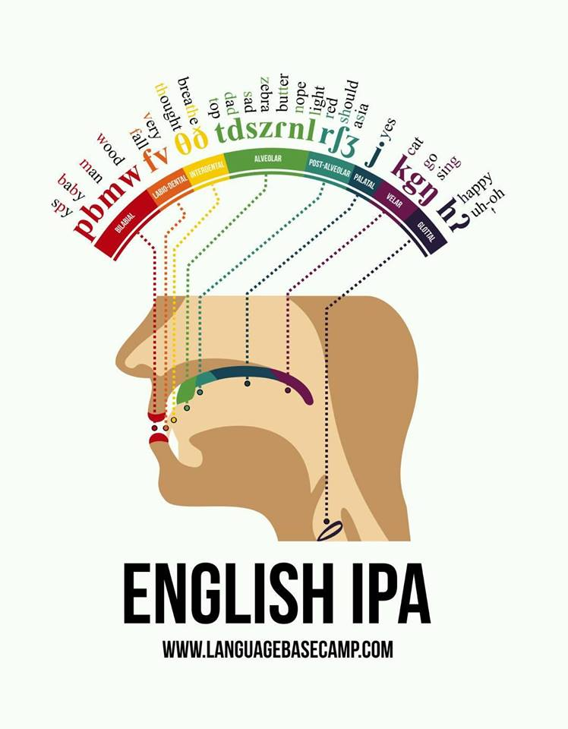
Consonants in English

Slide 5
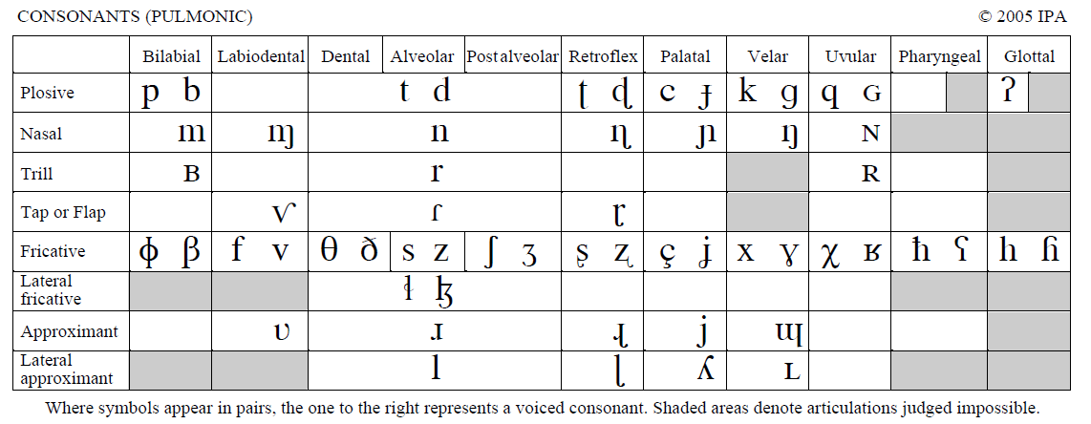
IPA Chart (consonants)
By IPA (http://www.langsci.ucl.ac.uk/ipa/ipachart.html) [CC-BY-SA-3.0 (http://creativecommons.org/licenses/by-sa/3.0)], via Wikimedia Commons

Slide 6
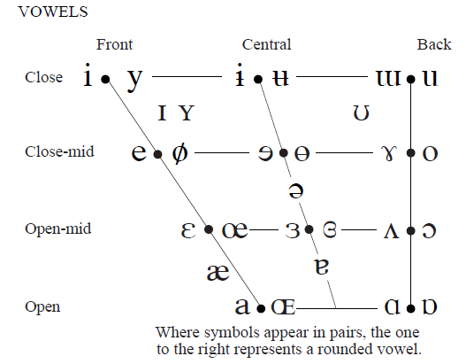
IPA Chart (vowels)
By IPA (http://www.langsci.ucl.ac.uk/ipa/ipachart.html) [CC-BY-SA-3.0 (http://creativecommons.org/licenses/by-sa/3.0)], via Wikimedia Commons
Notes:
Attribution?

Slide 7
(Many) Languages are Related
Cognates
night (English), nuit (French), Nacht (German), nacht (Dutch), nag (Afrikaans), nicht (Scots), natt (Swedish, Norwegian), nat (Danish), nátt (Faroese), nótt (Icelandic), noc (Czech, Slovak, Polish), ночь, noch (Russian), ноќ, noć (Macedonian), нощ, nosht (Bulgarian), ніч, nich (Ukrainian), ноч, noch/noč (Belarusian), noč (Slovene), noć (Serbo-Croatian), νύξ, nyx (Ancient Greek, νύχτα/nychta in Modern Greek), nox/nocte (Latin), nakt- (Sanskrit), natë (Albanian), noche (Spanish), nos (Welsh), nueche (Asturian), noite (Portuguese and Galician), notte (Italian), nit (Catalan), nuèch/nuèit (Occitan), noapte (Romanian), nakts (Latvian) and naktis (Lithuanian), all meaning "night" and derived from the Proto-Indo-European (PIE) *nókʷts, "night".
From wikipedia

Slide 8
Some Indo-European languages
Proto-Indo-European
Indo-Iranian
Hellenic
Italic
Balto-Slavic
Germanic
Sanskrit
Old Persian
Greek
Latin
Lithuanian
Russian
Polish
Old English
Old High German
Bengali
Urdu
Farsi
Romanian
French
Catalan
Modern English
German
Notes:
REDRAW

Slide 9
Some non-Indo-European Languages
Altaic
Turkish
Uralic (Finno-Ugric)
Finnish
Hungarian
Semitic
Arabic
Hebrew
Uto-Aztecan

Slide 10
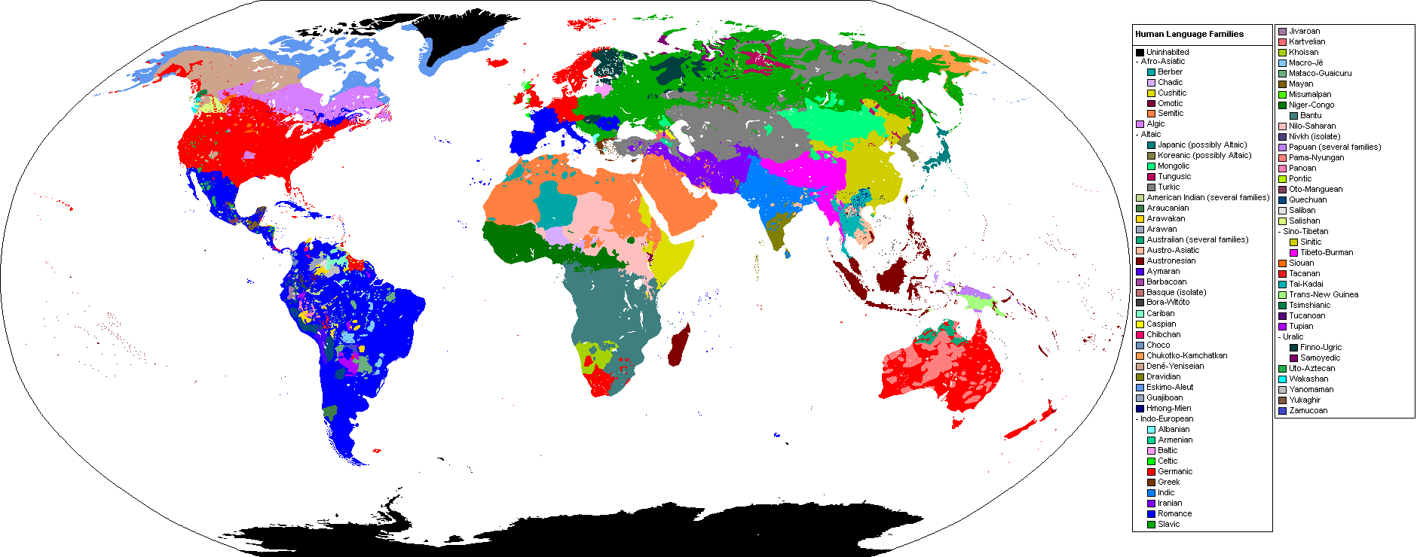
Language Families
By Industrius at English Wikipedia. Later version(s) were uploaded by Mttll at English Wikipedia. (Image:BlankMap-World.png by User:Vardion) [GFDL (www.gnu.org/copyleft/fdl.html)], via Wikimedia Commons

Slide 11
Language Diversity
Afro-Asiatic (374) Alacalufan (2) Algic (44) Altaic (66) Amto-Musan (2) Andamanese (13) Arafundi (3) Arai-Kwomtari (10) Arauan (5) Araucanian (2) Arawakan (59) Arutani-Sape (2) Australian (264) Austro-Asiatic (169) Austronesian (1257) Aymaran (3) Barbacoan (7) Basque (1) Bayono-Awbono (2) Border (15) Caddoan (5) Cahuapanan (2)
Carib (31) Central Solomons (4) Chapacura-Wanham (5) Chibchan (21) Chimakuan (1) Choco (12) Chon (2) Chukotko-Kamchatkan (5) Chumash (7) Coahuiltecan (1) Constructed language (1) Creole (82) Deaf sign language (130) Dravidian (85) East Bird’s Head-Sentani (8) East Geelvink Bay (11) East New Britain (7) Eastern Trans-Fly (4) Eskimo-Aleut (11) Guahiban (5) Gulf (4)
Harakmbet (2) Hibito-Cholon (2) Hmong-Mien (38) Hokan (23) Huavean (4) Indo-European (439) Iroquoian (9) Japonic (12) Jivaroan (4) Kartvelian (5) Katukinan (3) Kaure (4) Keres (2) Khoisan (27) Kiowa Tanoan (6) Lakes Plain (20) Language isolate (50) Left May (2) Lower Mamberamo (2) Lule-Vilela (1) Macro-Ge (32) Mairasi (3)
Maku (6) Mascoian (5)
Mataco-Guaicuru (12) Mayan (69) Maybrat (2) Misumalpan (4) Mixed language (23) Mixe-Zoque (17) Mongol-Langam (3) Mura (1) Muskogean (6) Na-Dene (46) Nambiquaran (7) Niger-Congo (1532) Nilo-Saharan (205) Nimboran (5) North Bougainville (4) North Brazil (1) North Caucasian (34) Oto-Manguean (177) Panoan (28)
Pauwasi (5) Peba-Yaguan (2) Penutian (33) Piawi (2) Pidgin (17) Quechuan (46) Ramu-Lower Sepik (32) Salishan (26) Salivan (3) Senagi (2) Sepik (56) Sino-Tibetan (449) Siouan (17) Sko (7) Somahai (2) South Bougainville (9) South-Central Papuan (22) Tacanan (6) Tai-Kadai (92) Tarascan (2) Tequistlatecan (2) Tor-Kwerba (24)
Torricelli (56) Totonacan (12) Trans-New Guinea (477) Tucanoan (25) Tupi (76) Unclassified (73) Uralic (37) Uru-Chipaya (2) Uto-Aztecan (61) Wakashan (5) West Papuan (23) Witotoan (6) Yanomam (4) Yele-West New Britain (3) Yeniseian (2) Yuat (6) Yukaghir (2) Yuki (2) Zamucoan (2) Zaparoan (7)
Ethnologue (7358 languages)

Slide 12
Language Changes
Grimm’s Law
Voiceless stops turn into voiceless fricatives
Voiced stops become voiceless stops
Voiced aspirated stops change to voiced stops or fricatives
Example 1
Ancient Greek: πούς, Latin: pēs, Sanskrit: pāda
English: foot, German: Fuß, Swedish: fot
Example 2
Ancient Greek: κύων, Latin: canis, Welsh: ci
English: hound, Dutch: hond, German: Hund

Slide 13

NACLO Problem
http://nacloweb.org/resources/problems/2012/N2012-D.pdf
http://nacloweb.org/resources/problems/2012/N2012-DS.pdf
Problem by Dragomir Radev
http://unicode.org/udhr/assemblies/first_article_all.html

Slide 14
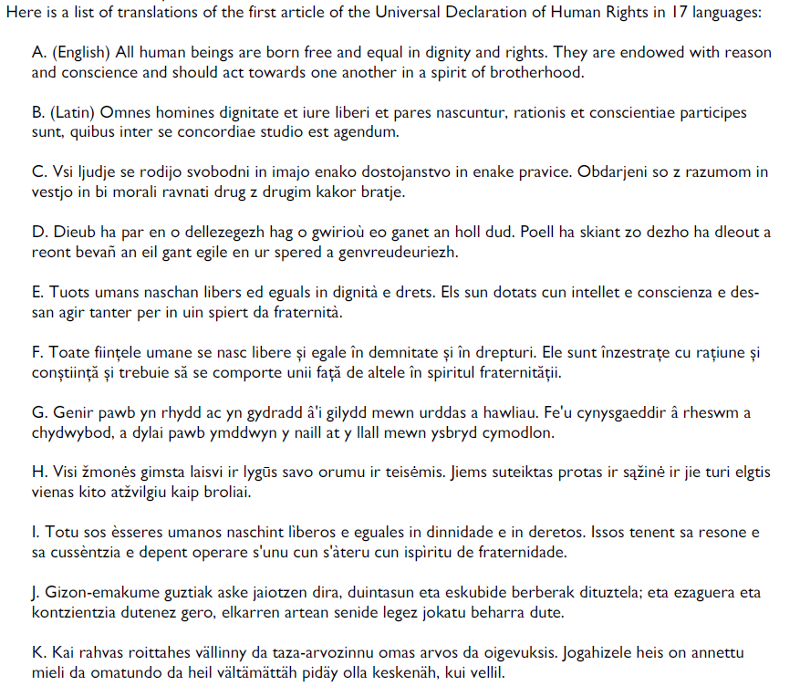

Slide 15
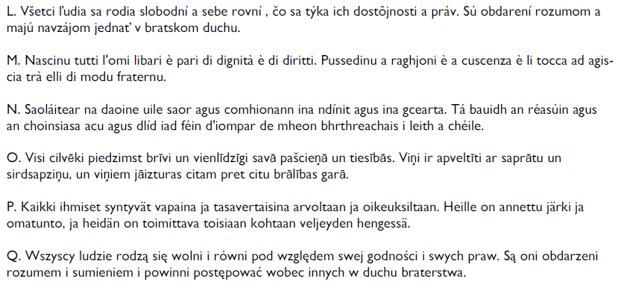

Slide 16
English
Latin
Slovenian
Breton
Romansch
Romanian
Welsh
Lithuanian
Sardinian
Basque
Karelian

Slide 17
Slovak
Corsican
Irish
Latvian
Finnish
Polish

Slide 18
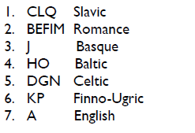
Language Families

Slide 19
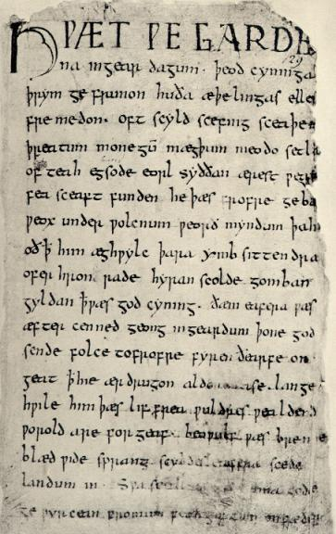
Question
Can you guess the source, language, and period of this text?

Slide 20
Answer
Beowulf
Epic poem
8th-11th Century
Old English

Slide 21
Beowulf
Hwæt! We Gardena in geardagum,
þeodcyninga, þrym gefrunon,
hu ða æþelingas ellen fremedon.
Oft Scyld Scefing sceaþena þreatum,
monegum mægþum, meodosetla ofteah,
egsode eorlas. Syððan ærest wearð
feasceaft funden, he þæs frofre gebad,
weox under wolcnum, weorðmyndum þah,
oðþæt him æghwylc þara ymbsittendra
erst (as in erstwhile) = first
Lo! the Spear-Danes’ glory through splendid achievements
The folk-kings’ former fame we have heard of,
How princes displayed then their prowess-in-battle.
Oft Scyld the Scefing from scathers in numbers
From many a people their mead-benches tore.
Since first he found him friendless and wretched,
The earl had had terror: comfort he got for it,
Waxed ’neath the welkin, world-honor gained,
Till all his neighbors o’er sea were compelled to …
http://lit.genius.com/ http://www8.georgetown.edu/departments/medieval/labyrinth/library/oe/texts/a4.1.html
http://www.gutenberg.org/files/16328/16328-h/16328-h.htm
http://www.nvcc.edu/home/vpoulakis/Translation/beowulf1.htm
http://en.wikipedia.org/wiki/File:Beowulf.firstpage.jpeg

Slide 22
ATHELING.—Prince, nobleman.
BAIRN.—Son, child.
BARROW.—Mound, rounded hill, funeral-mound.
BATTLE-SARK.—Armor.
BEAKER.—Cup, drinking-vessel.
BEGEAR.—Prepare.
BIGHT.—Bay, sea.
BILL.—Sword.
BOSS.—Ornamental projection.
BRACTEATE.—A round ornament on a necklace.
BRAND.—Sword.
BURN.—Stream.
BURNIE.—Armor.
CARLE.—Man, hero.
EARL.—Nobleman, any brave man.
EKE.—Also.
EMPRISE.—Enterprise, undertaking.
ERST.—Formerly.
ERST-WORTHY.—Worthy for a long time past.
FAIN.—Glad.
FERRY.—Bear, carry.
FEY.—Fated, doomed.
FLOAT.—Vessel, ship.
FOIN.—To lunge (Shaks.).
GLORY OF KINGS.—God.
GREWSOME.—Cruel, fierce.
HEFT.—Handle, hilt; used by synecdoche for ‘sword.’
HELM.—Helmet, protector.
HENCHMAN.—Retainer, vassal.
HIGHT.—Am (was) named.
HOLM.—Ocean, curved surface of the sea.
HIMSEEMED.—(It) seemed to him.
LIEF.—Dear, valued.
MERE.—Sea; in compounds, ‘mere-ways,’ ‘mere-currents,’ etc.
MICKLE.—Much.
NATHLESS.—Nevertheless.
NAZE.—Edge (nose).
NESS.—Edge.
NICKER.—Sea-beast.
QUIT, QUITE.—Requite.
RATHE.—Quickly.
REAVE.—Bereave, deprive.
SAIL-ROAD.—Sea.
SETTLE.—Seat, bench.
SKINKER.—One who pours.
SOOTHLY.—Truly.
SWINGE.—Stroke, blow.
TARGE, TARGET.—Shield.
THROUGHLY.—Thoroughly.
TOLD.—Counted.
UNCANNY.—Ill-featured, grizzly.
UNNETHE.—Difficult.
WAR-SPEED.—Success in war.
WEB.—Tapestry (that which is ‘woven’).
WEEDED.—Clad (cf. widow’s weeds).
WEEN.—Suppose, imagine.
WEIRD.—Fate, Providence.
WHILOM.—At times, formerly, often.
WIELDER.—Ruler. Often used of God;
WIGHT.—Creature.
WOLD.—Plane, extended surface.
WOT.—Knows.
YOUNKER.—Youth.

Slide 23
Diversity of languages
Articles
Cases (e.g., in Latin)
Puer puellam vexat
Sound systems
Glottal stop (the middle sound in “uh-oh”) - pro
Velar fricatives - articulated with the back of the tongue at the soft palate
Voiceless /x/ - used e.g., in Russian
Voiced /ɣ/ - used e.g., in Modern Greek
Social status (e.g., in Japanese)
otousan, お父さん = someone else‘s father
chichi, 父 = one’s own father
Kinship systems (e.g., in Warlpiri) – see next slide

Slide 24
NACLO Problem
Warlpiri Kinship – by Alan Chang
http://www.nacloweb.org/resources/problems/2013/N2013-O.pdf

Slide 25
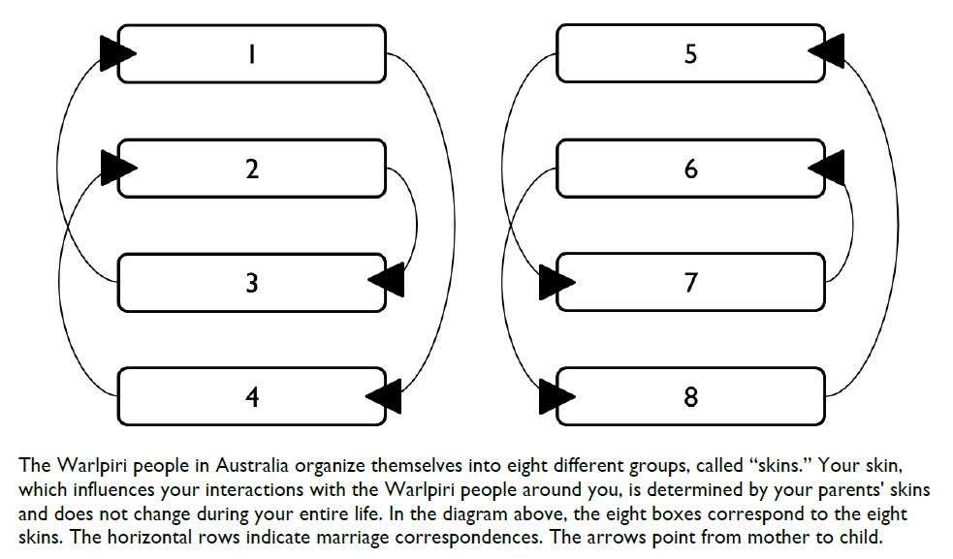

Slide 26
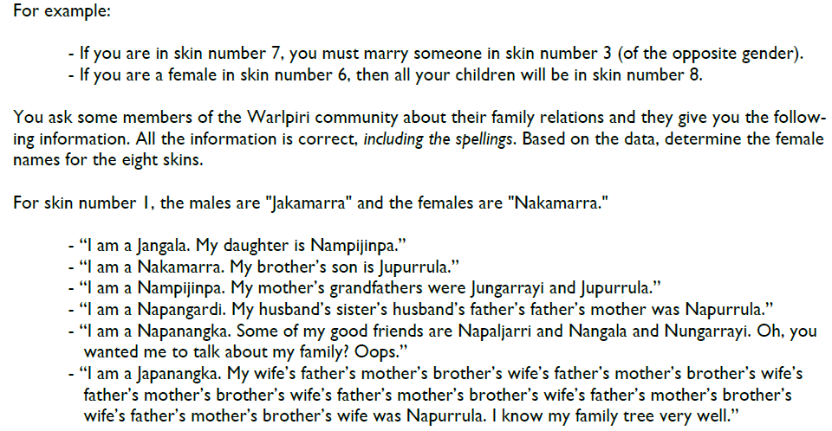

Slide 27
NACLO Solution
Warlpiri Kinship
http://www.nacloweb.org/resources/problems/2013/N2013-OS.pdf

Slide 28
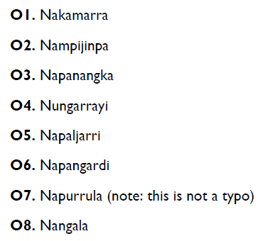

Slide 29
Language Universals
Two types
unconditional
conditional
Examples
All languages have verbs and nouns
All spoken languages have consonants and vowels
[Greenberg 1] “In declarative sentences with nominal subject and object, the dominant order is almost always one in which the subject precedes the object.“
[Greenberg 29] “If a language has inflection, it always has derivation.“

Slide 30
WALS: the World Atlas of Language Structures
http://wals.info
Feature 83A: Order of Object and Verb
by Matthew S. Dryer
OV (713 languages), VO (705), no dominant order (101)
http://wals.info/feature/83A#2/18.0/152.9
Other features:
18A Absence of common consonants (by Ian Maddieson): no bilabials (5 languages), no fricatives (49), no nasals (12)
67A Inflectional future tense (by Östen Dahl, Viveka Velupillai): yes (110), no (112)

Slide 31
Links about World Languages
Ethnologue
http://www.ethnologue.com/
Number words in many languages
http://www.zompist.com/numbers.shtml
Endangered languages
http://www.endangeredlanguages.com/
Google fights to save 3,054 dying languages
http://www.cnn.com/2012/06/21/tech/web/google-fights-save-language-mashable/index.html
Notes:
Add titles

Slide 32
NLP

